Slide 1

Raising Up New Programs of Growth
“…we will call upon the community of the Most Great Name at Riḍván 2011 to raise over the next five years the total number of clusters in which a programme of growth is under way, at whatever level of intensity, to 5,000, approximately one third of all clusters in the world at present.”
–Universal House of Justice, 28 Dec. 2010

Slide 2
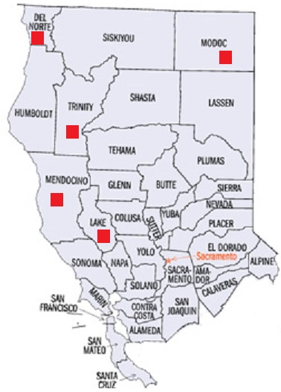
California clusters in need of support
Driving times from Berkeley:
Lake County: 2.5 hours
Mendocino:
Inland: 2 hours
Coastal: 3.25 hours
Trinity County: 4 hours
Modoc County: 5.75 hours
Del Norte County: 6.25 hours

Slide 3
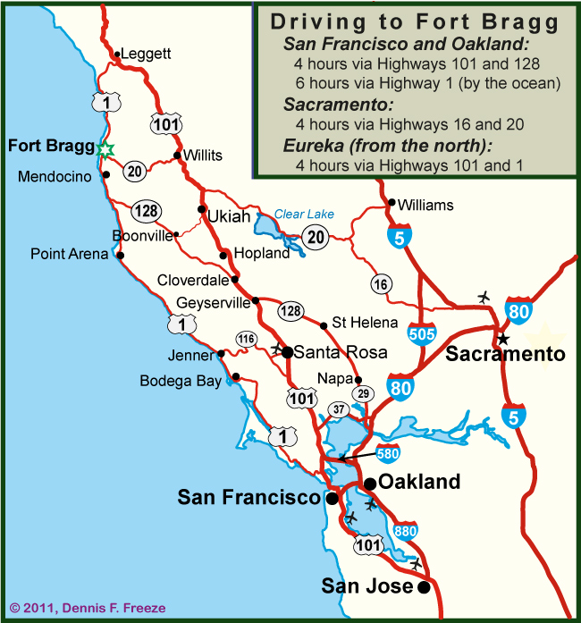
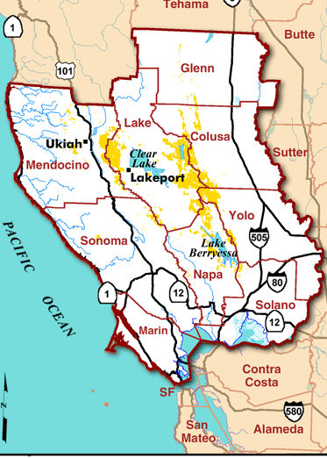
Mendocino County
Two main areas:
Inland (Ukiah)
Coastal (For Bragg, Mendocino, Point Arena)

Slide 4


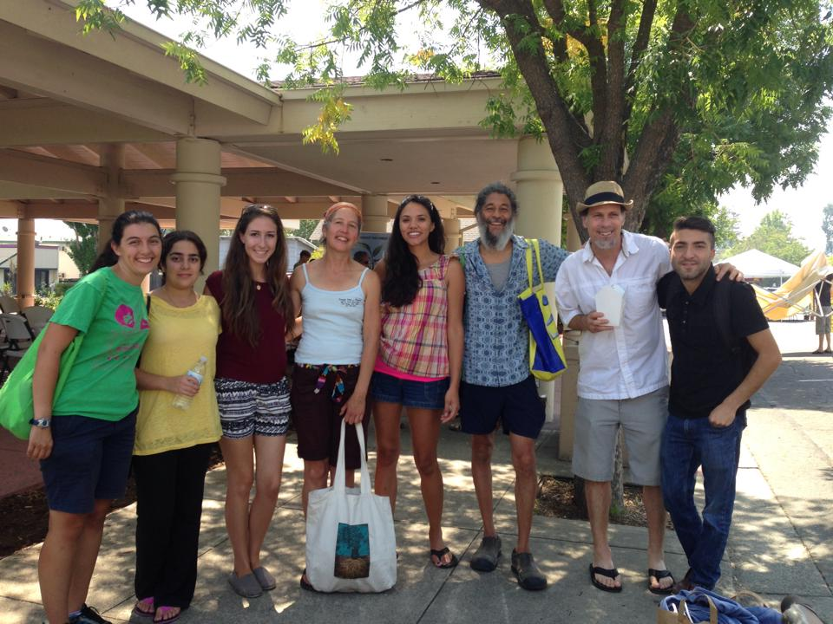
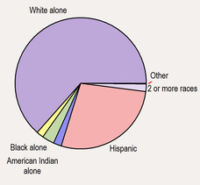
Mendocino County: Ukiah
Population: 16,000 (+2.6% since 2000)
Schools:
6 Elementary
3 Middle (1 charter)
3 High (1 charter)
1 college

Slide 5
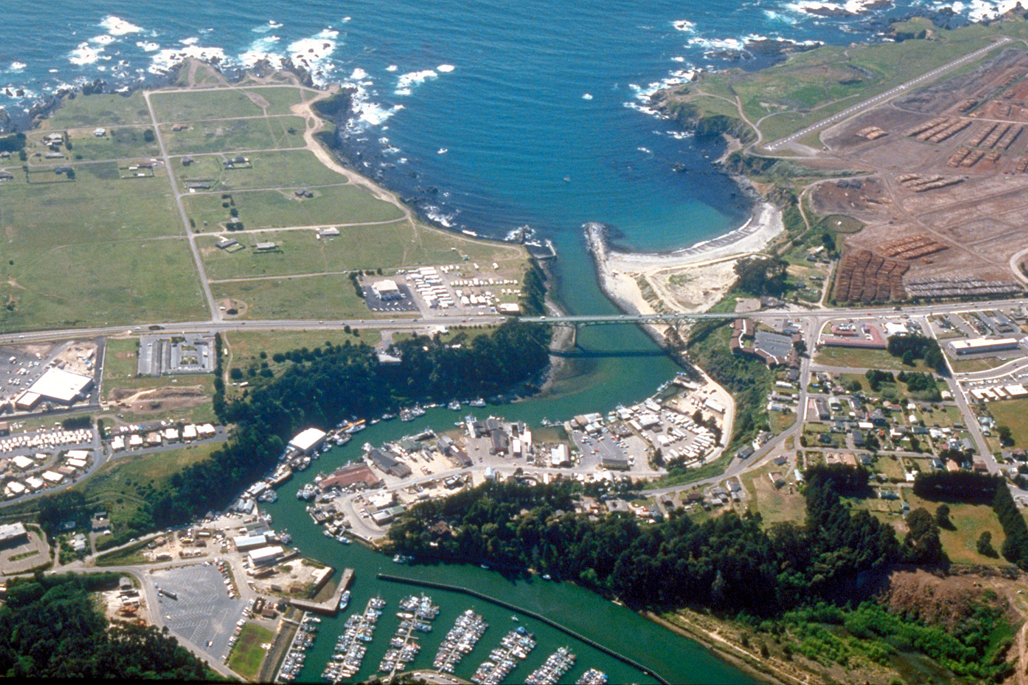
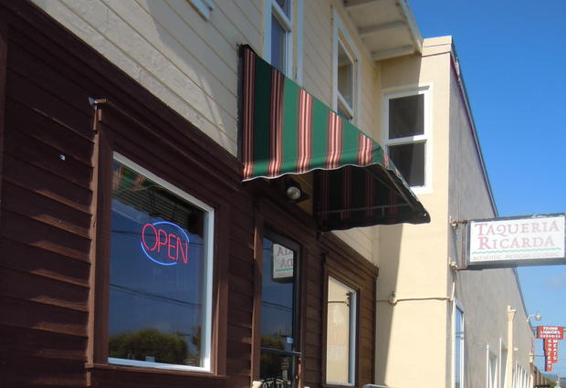
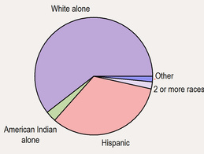


Mendocino County: Fort Bragg
Population: 7,300
Households: 2,800
30% with children <18 yrs old
12% below the poverty line
Schools:
2 elementary
1 middle
1 high school
1 adult school

Slide 6
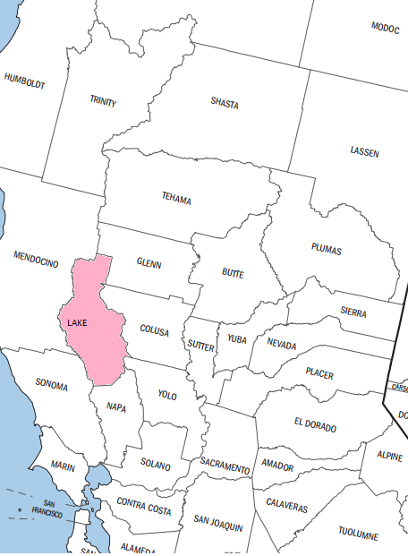
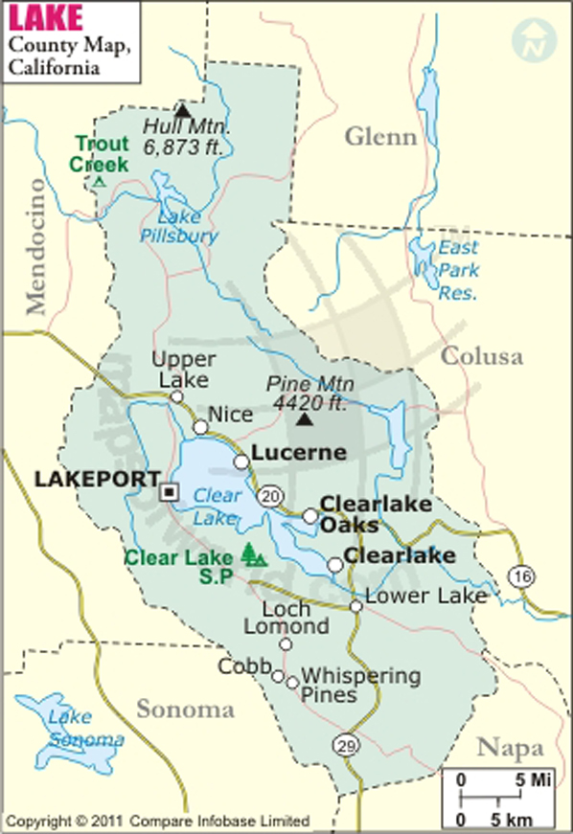
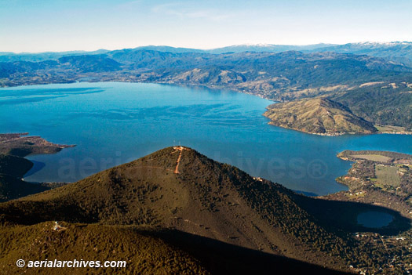
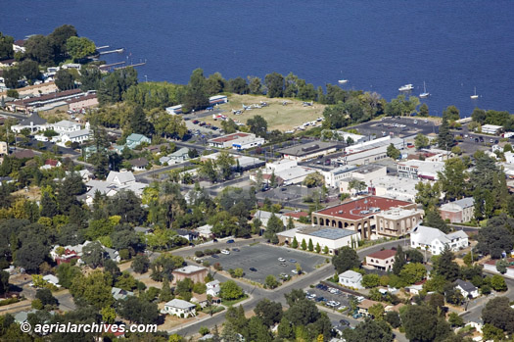
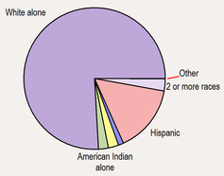
Lake County
Population:
Clearlake- 15,000
Lakeport- 4,800
Lucrene- 3,000
Clearlake Oaks- 2,400

Slide 7
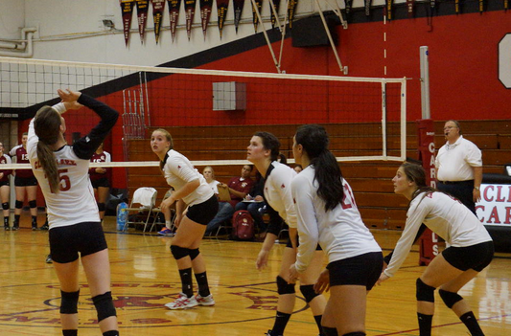
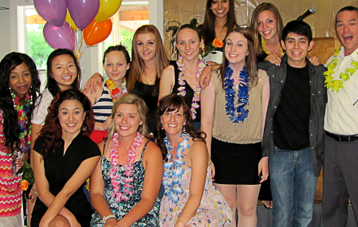
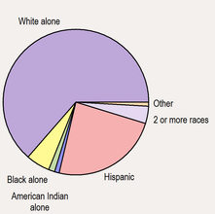
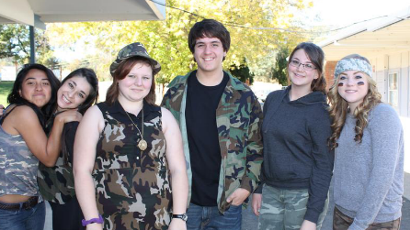
Clearlake, CA
Clearlake Schools: 4 K-8, 1 High

Slide 8
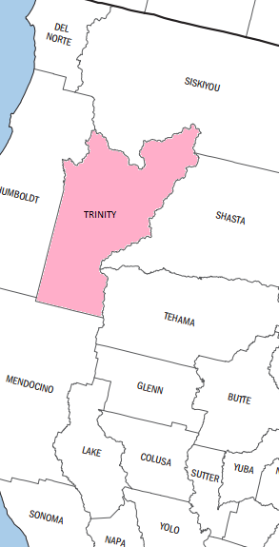
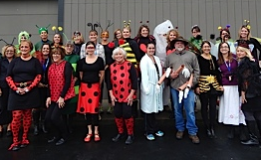
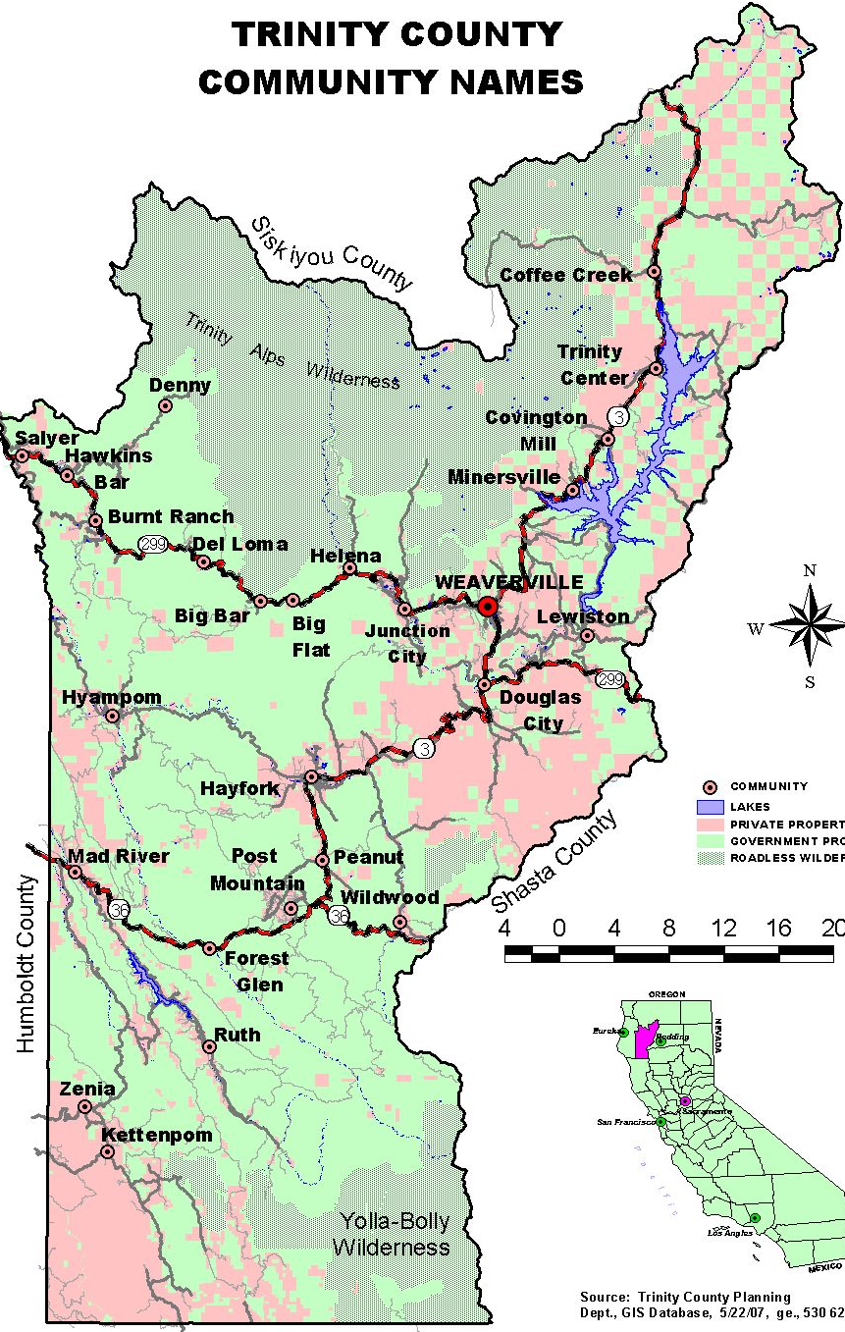

Trinity County
Total Population: 13,400
Weaverville: 3,600 (2: K-8, 2: 9-12)
Hayfork: 2,400 (2: K-8, 1: 7-12, 2: 9-12)
Lewiston: 1,200 (1: K-8)
Douglas City: 700 (1: K-8)
Junction City: 700 (1: K-8)

Slide 9
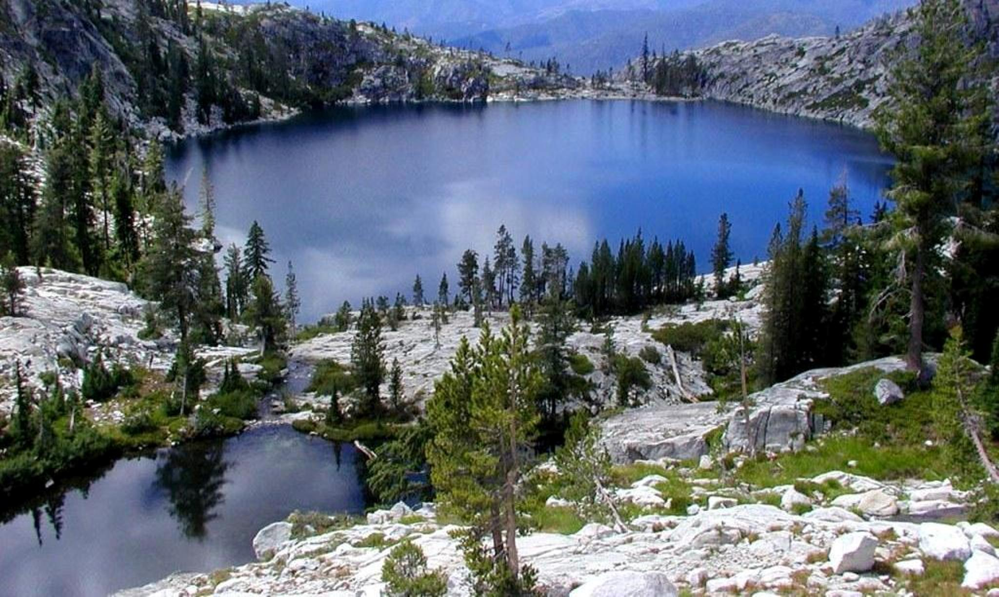
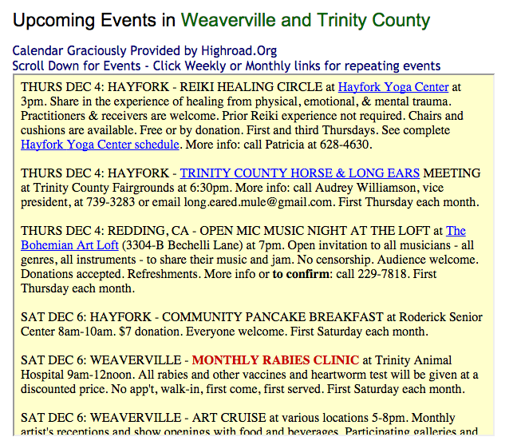
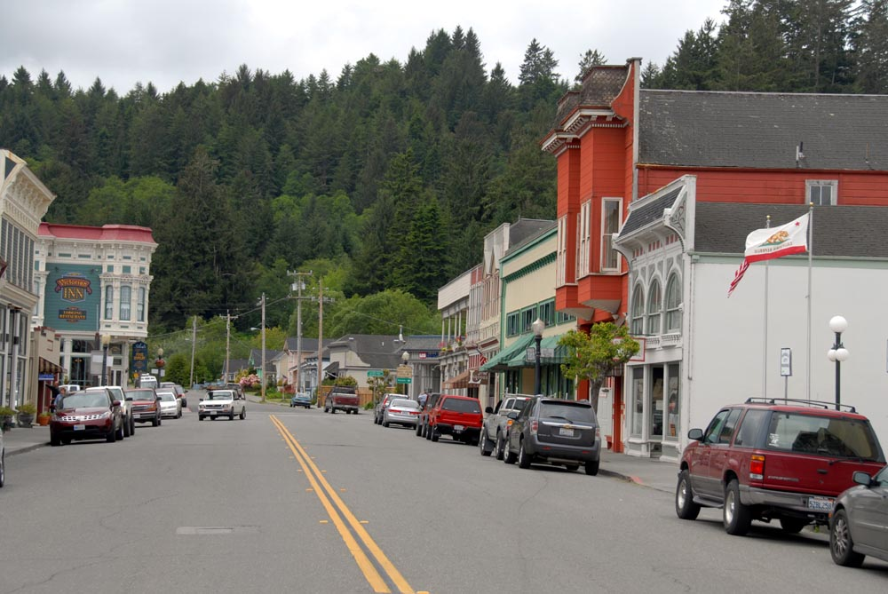
Trinity County

Slide 10
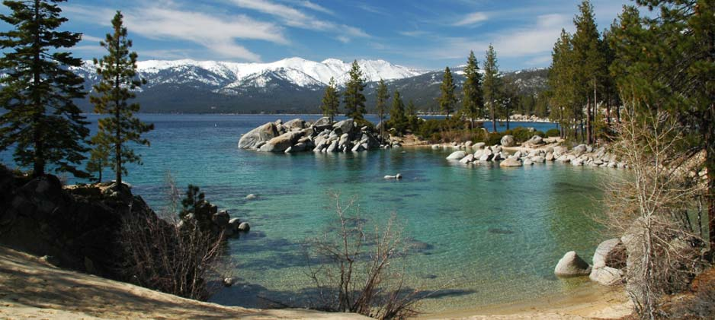
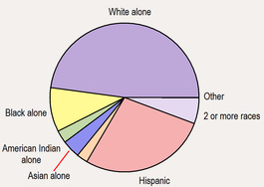

Del Norte County (Crescent City)
Del Norte Population: 27,900 (66% urban)
Crescent City Population: 7,400
Crescent City Schools:
4 Elementary (K-5)
1 Middle (6-8)
2 High (9-12)
2 Charter (1: K-12, 1: K-8)

Slide 11
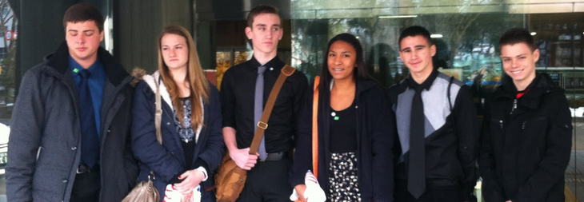

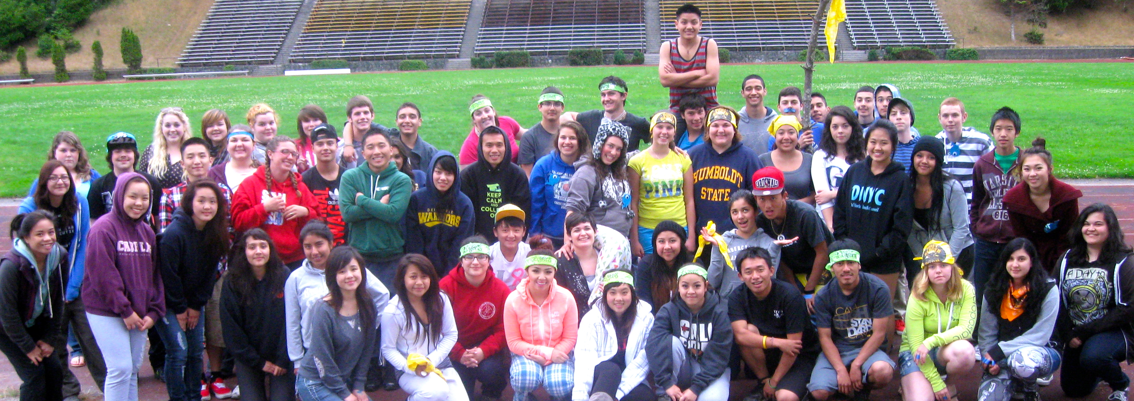

Del Norte County (Crescent City)
H.S. Clubs:

Slide 12
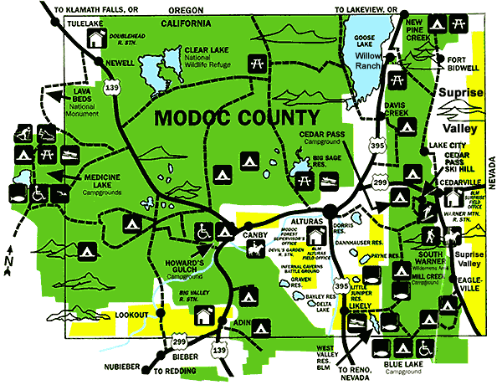
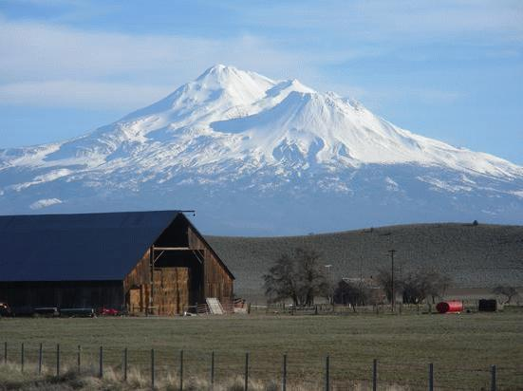
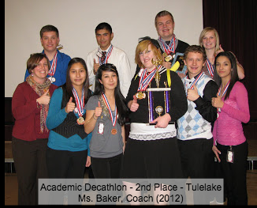
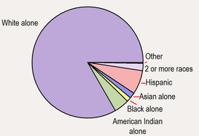
Modoc County
Modoc County Pop.: 9,100
Alturas, CA Pop.: 2,700
Alturas Schools: 1 elementary, 1 middle, 1 high

Slide 13
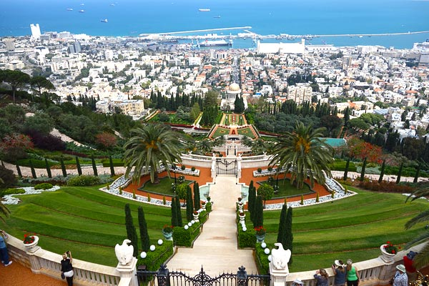
“The desire to pioneer arises naturally from deep within the heart of the individual believer as a response to the Divine summons. Whosoever forsakes his or her home for the purpose of teaching the Cause joins the ranks of those noble souls whose achievements down the decades have illumined the annals of Bahá’í pioneering. We cherish the hope that many will be moved to render this meritorious service during the next Plan, whether on the home front or in the international field—an act that, in itself, attracts untold blessings…”
–Universal House of Justice, 27 Dec. 2005

